Slide 1
Technical Standards Committee
10th May 2018

Slide 2
How did we get here?

Slide 3
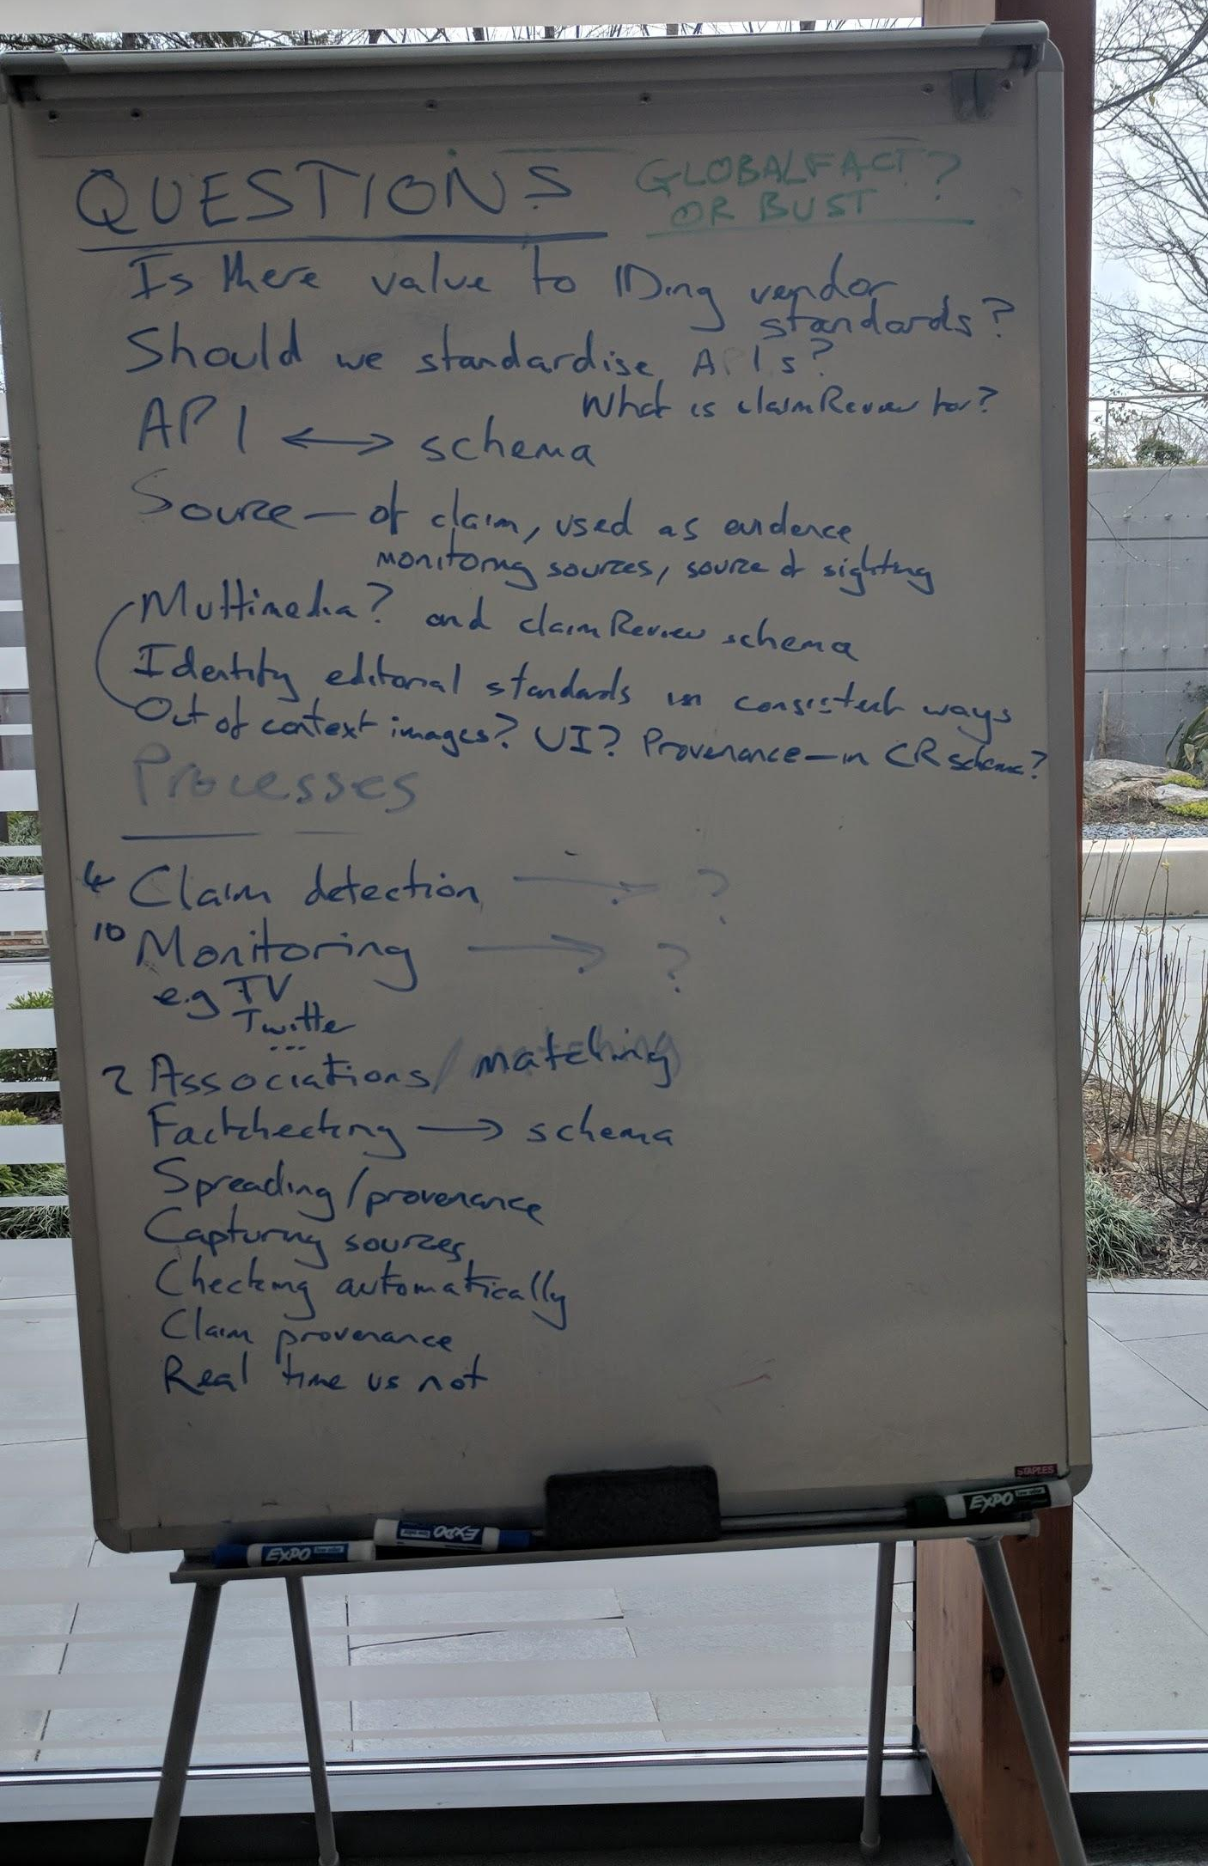
Processes or items we identified as needing a standard at Tech&Check
Processes
Monitoring
Spotting/Detection
Automatic checking
Claim matching
Items
Factchecks
Automatic checks
Knowledge bases
Spread

Slide 4
Stages of automated factchecking:
Monitoring news, social media, public debate
Spotting claims to factcheck
Checking the claims
Publishing factchecks, or other interventions

Slide 5
Monitoring
Spotting
Checking
Publishing
Newspapers
Parliament or Congress
Claim
Social Media

Slide 6
We want to
See if it’s possible to standardise our monitoring
To achieve useful interoperability between our systems
And to conserve limited resource
So if Chequeado built 100 scrapers it could be used by Politifact the next day.

Slide 7
The Road To #GlobalFact*
May 10th: Understand everyone’s current position
May 18th: Discuss requirements and plausible options
June 1st: Decide on an option, discuss practicalities
June 13th: Champagne
*this is a very ambitious plan that is subject to change

Slide 8
Questions
Are you/will you be doing any monitoring?
What do you monitor? eg News, Social media
What do you capture? What for?
Is there anything that you capture that isn’t straightforward? Or would like to?
Are you using any common standards or input formats at the moment?
Are you familiar with solutions that already exist to answer this problem?

Slide 9
Task
Please write up what you want to be monitoring and what you would like to be doing with the output of that monitoring?
Send to mevan@fullfact.org by next Thursday 17th, 3pm BST/10am ET.
Next meeting Friday 18th, 4pm BST/11am ET.

Slide 10
Thanks!

